Slide 1
Teaching and Learning about AI with Tangible Approaches
2025 AIGR Professional Development Series
Feb 21th, 2025
School of Education
Indiana University Bloomington

Slide 2
Slide Deck
bit.ly/aigrpd25

Slide 3
Introductions

Slide 4
Program Overview
Build teacher capacity for AI Education in rural schools
Develop integrated curricula in collaboration with middle school STEM teachers on Artificial Intelligence
Develop learning activities students enjoy
Apply ideas students have learned, as well as focusing on the real-world applications and ethical implications of AI

Slide 5
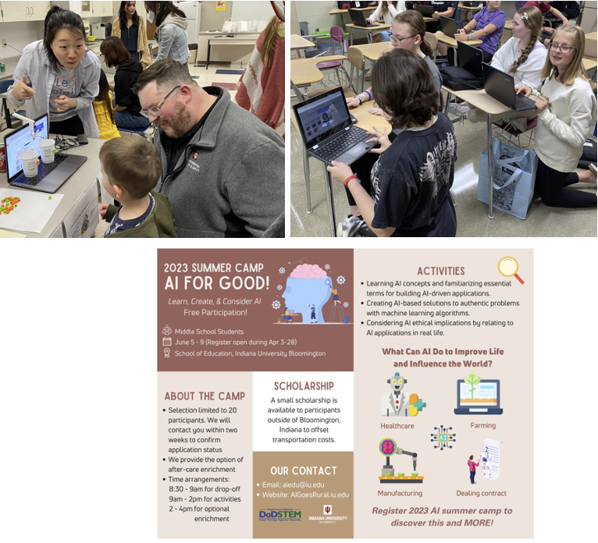
Program Activities
Professional Development
Co-design with teachers
Summer camp (AI for Me) in 2022
Summer camp (AI for Good) in 2023

Slide 6
6

Slide 7
Website
https://aigoesrural.iu.edu/

Slide 8
What is Artificial?
What is Intelligence?
Made by humans; produced by humans (opposed to natural): artificial flowers
An organism uses data to improve decision making

Slide 9
What is AI?
A way for a computer program to work “intelligently”
The art of teaching computers how to "think."
A discipline concerned with the designing of computers that make predictions and decisions.

Slide 10
AI Learning Tools
Quick, Draw!
https://quickdraw.withgoogle.com/

Slide 11
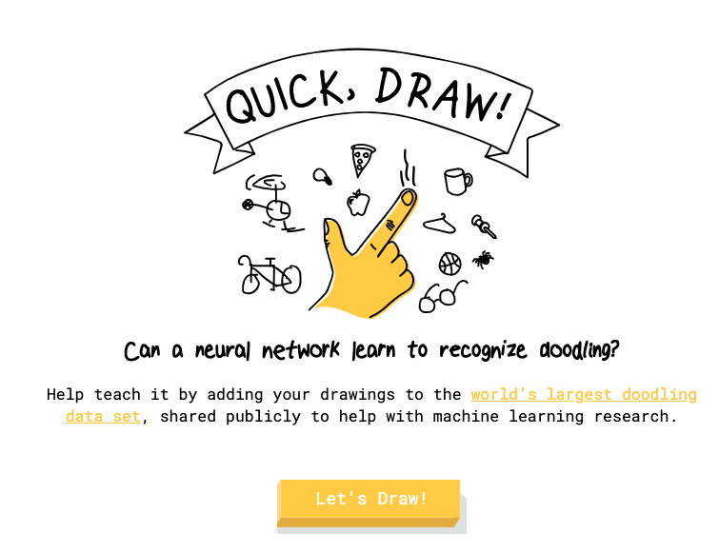
Quick, Draw!

Slide 12
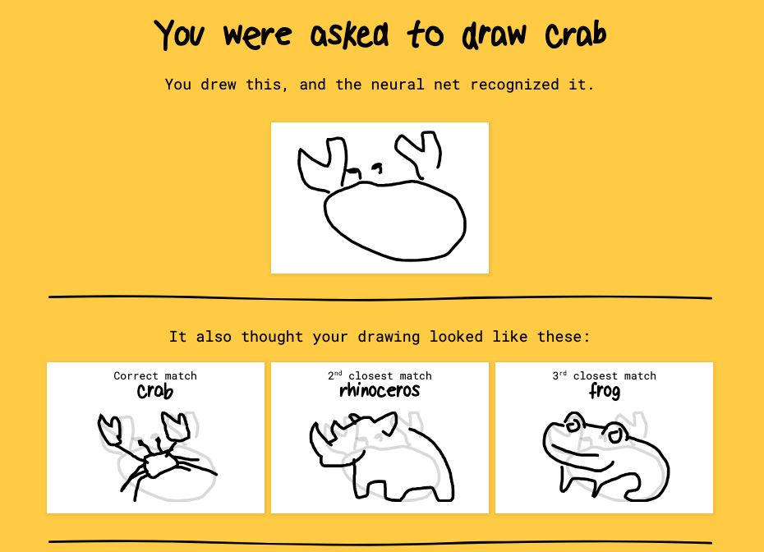
Quick, Draw!

Slide 13
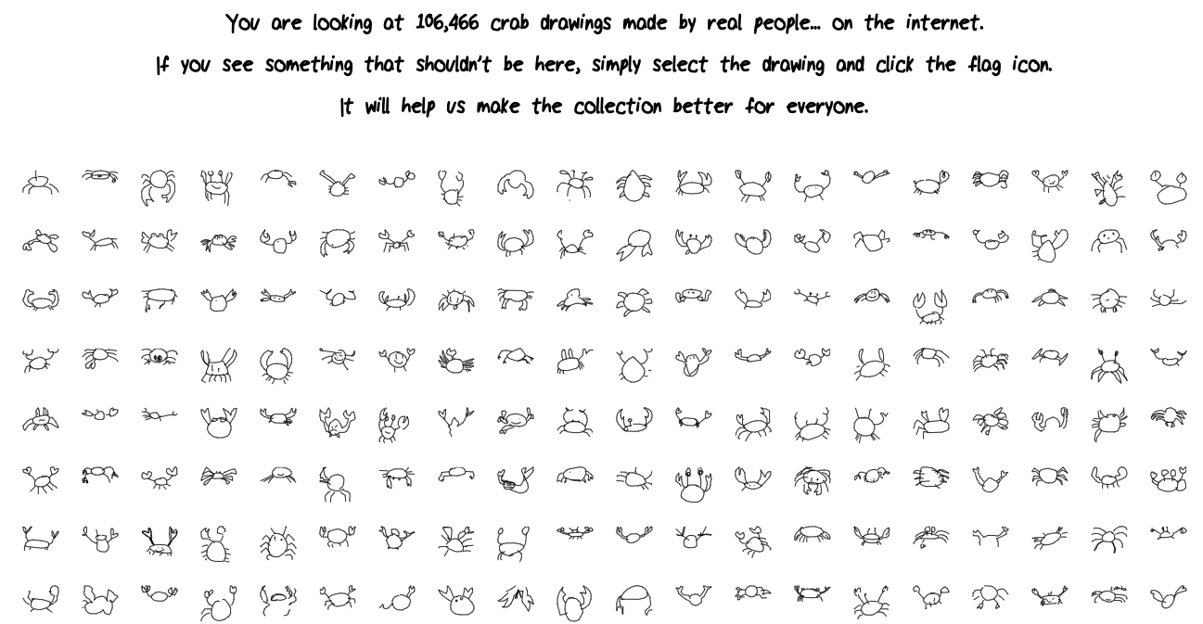
Quick, Draw!

Slide 14
AI Learning Tools
Be my Eyes
https://www.bemyeyes.com/mobile-app

Slide 15
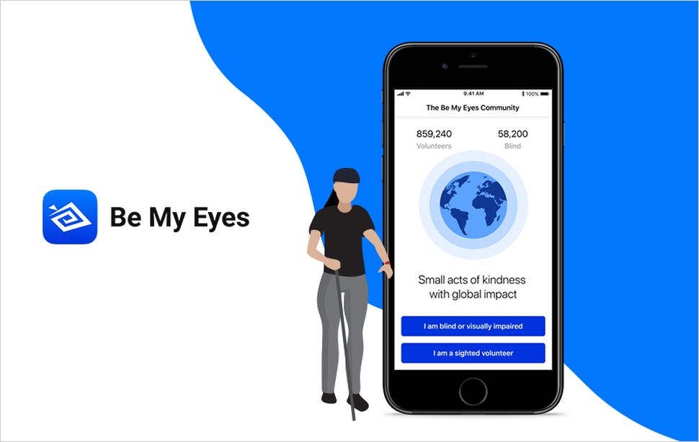
Be my eyes
AI-driven tool integrated into Be My Eyes to assist blind and low vision users.
Uses OpenAI’s GPT-4 Vision Model to describe images and provide customer support.
Notes:
Here, we are going to do an ice-breaking activity with the AI-based app called Seeing AI.
It is an AI-based app designed with and for the blind and low vision community utilizing the power of AI to open up the visual world.
It can assist with daily tasks from reading, to describing photos, to identifying products, and more.
Through this activity, we will explore what AI can do, and take a quick look about how AI works.

Slide 16
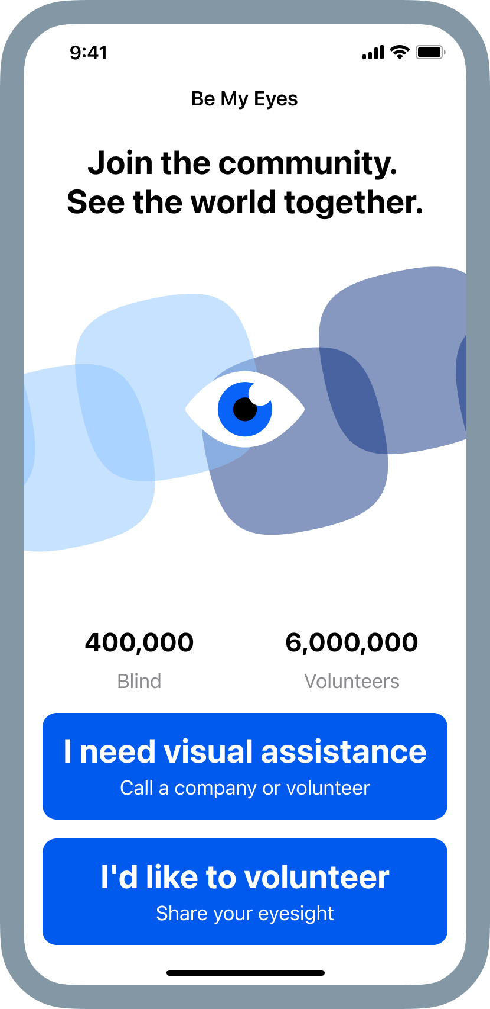
Be my eyes (app)
Let's use iPads/Phone to explore the app!
(Pw: aigr00)
Please choose "I need visual assistance" button and log in using your Google account.

Slide 17
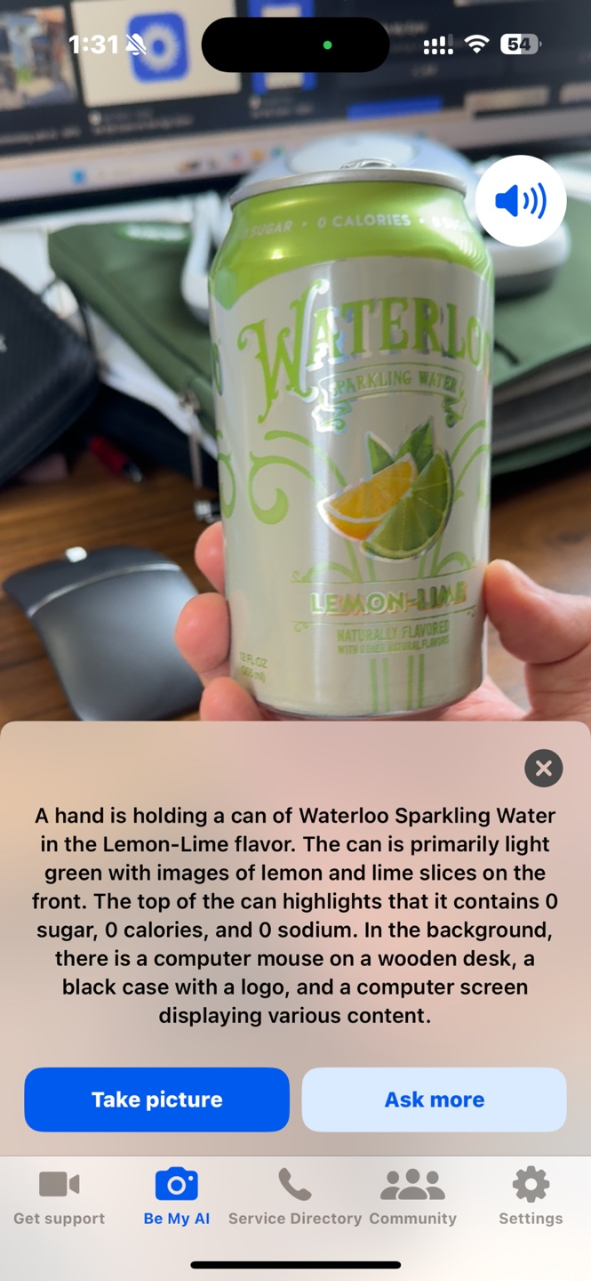
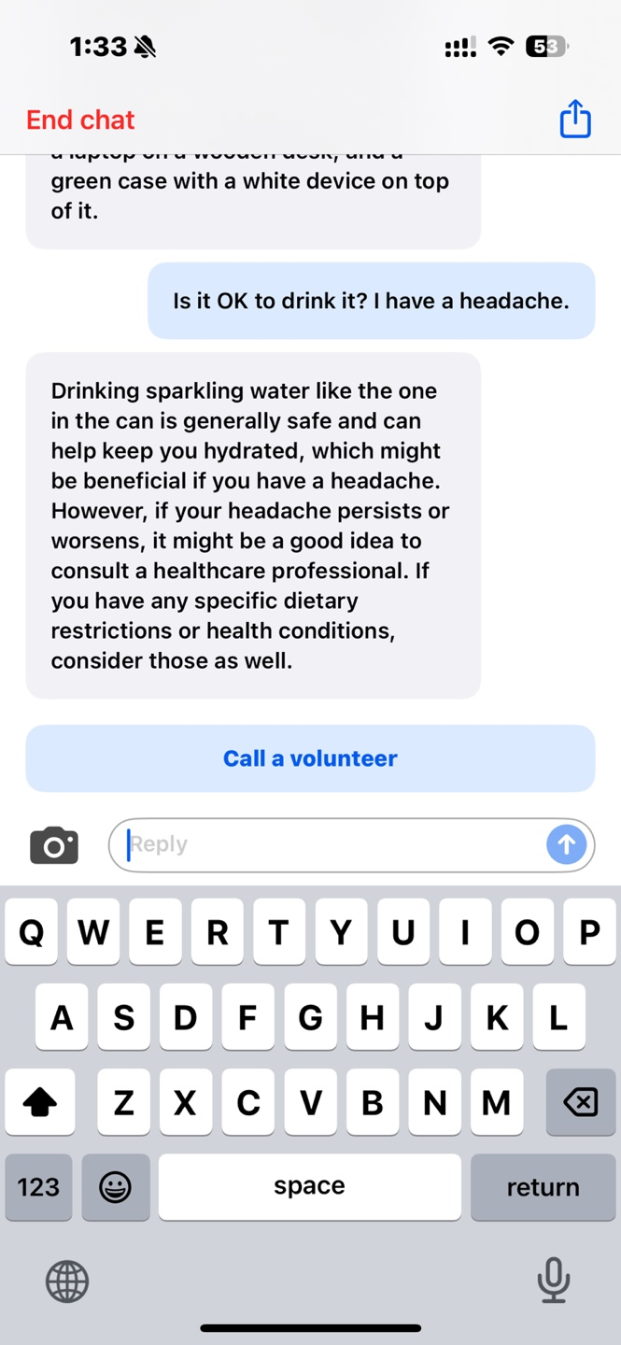
Be my eyes
Take a picture, and AI will describe what’s in front of the camera.
Ask follow-up questions to AI-chatbot to get deeper insights.

Slide 18
Be my eyes
Click "Call a Volunteer" to get live help.
Can join the community and assist low-vision users.

Slide 19
Be my eyes
What types of information does the Be My Eyes app provide to users?
What key AI concepts enable the Be My Eyes app to function effectively?
✅ Computer Vision – AI analyzes and interprets images. ✅ Natural Language Processing (NLP) – AI generates human-like descriptions. ✅ Human-AI Collaboration – Volunteers provide additional support. ✅ Accessibility & Inclusive Design – Ensuring usability for blind and low-vision users.
Notes:
Okay, hope you have some fun with this app.
Then, we can think of this question.
What types of information can the Seeing AI app provide, and which AI concepts does it use to do so?

Slide 20
What is ML(machine learning)?
Machine Learning (ML) is a process when AI learns for itself through data and experience
Enable AI systems to come up with their own solutions
Complete certain tasks at great speed and scale
When you think of ML, who or what do you think of?

Slide 21
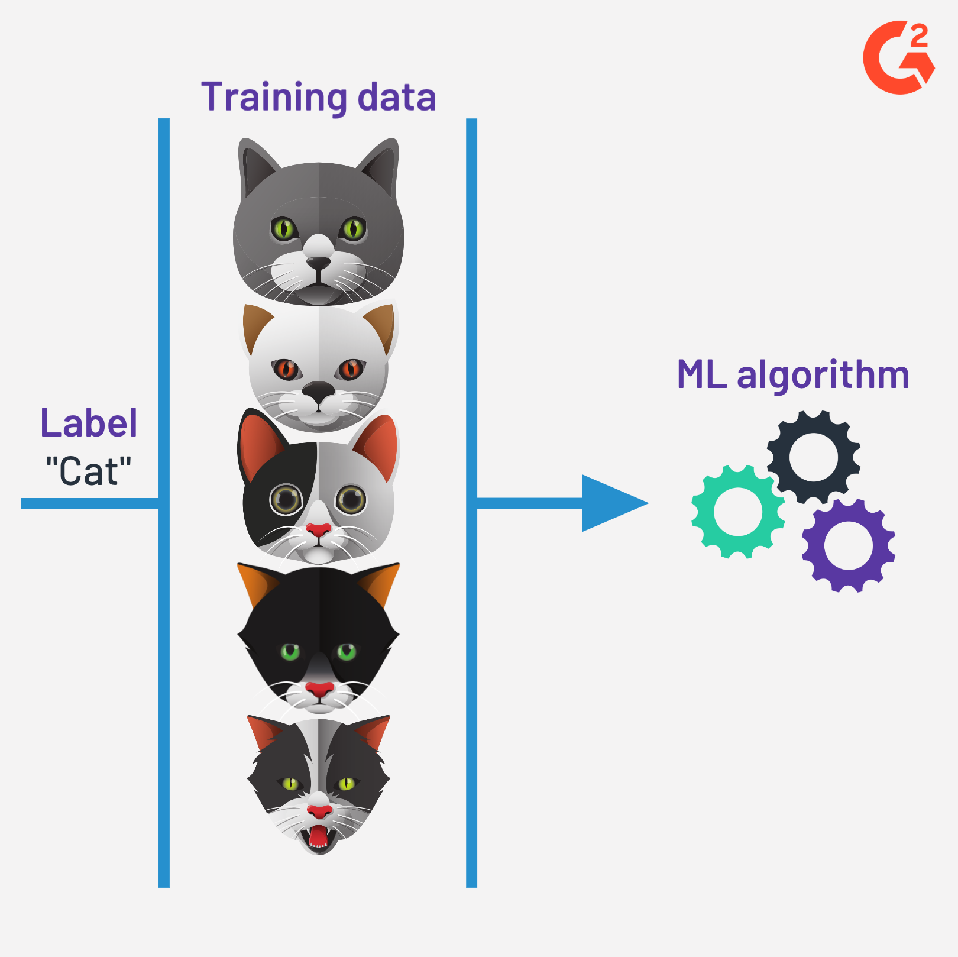
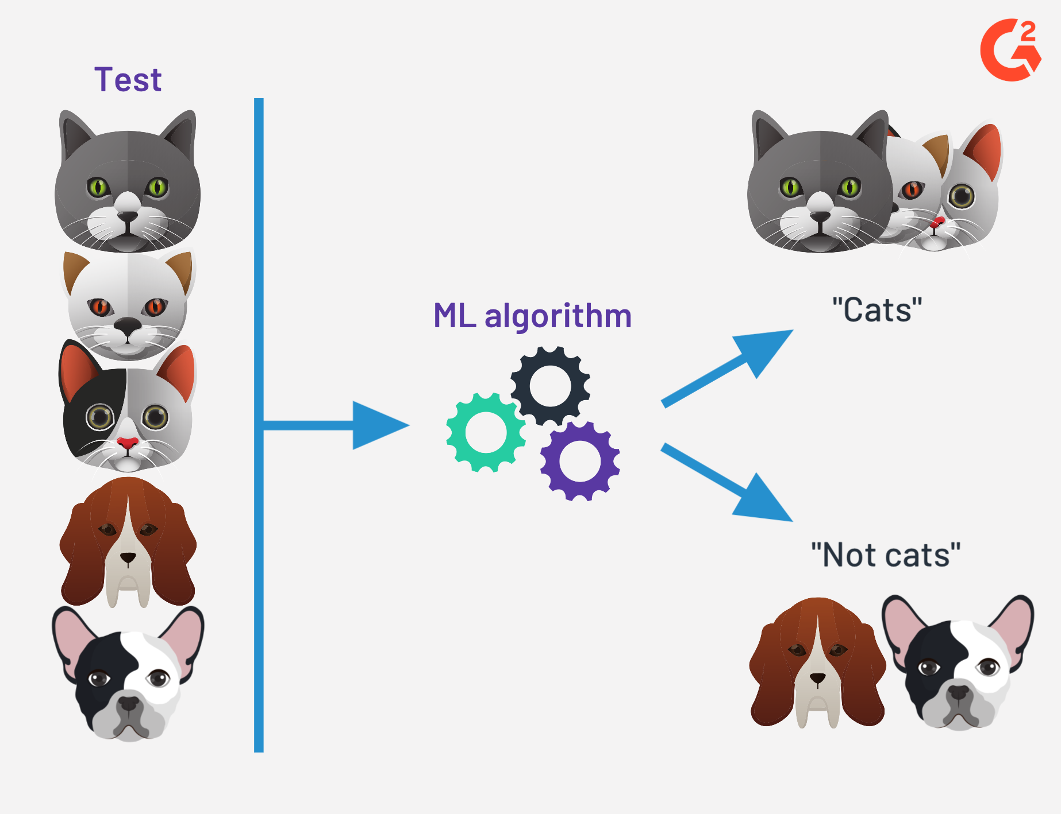
What is ML (Supervised)?
Train an AI model with labeled data

Slide 22
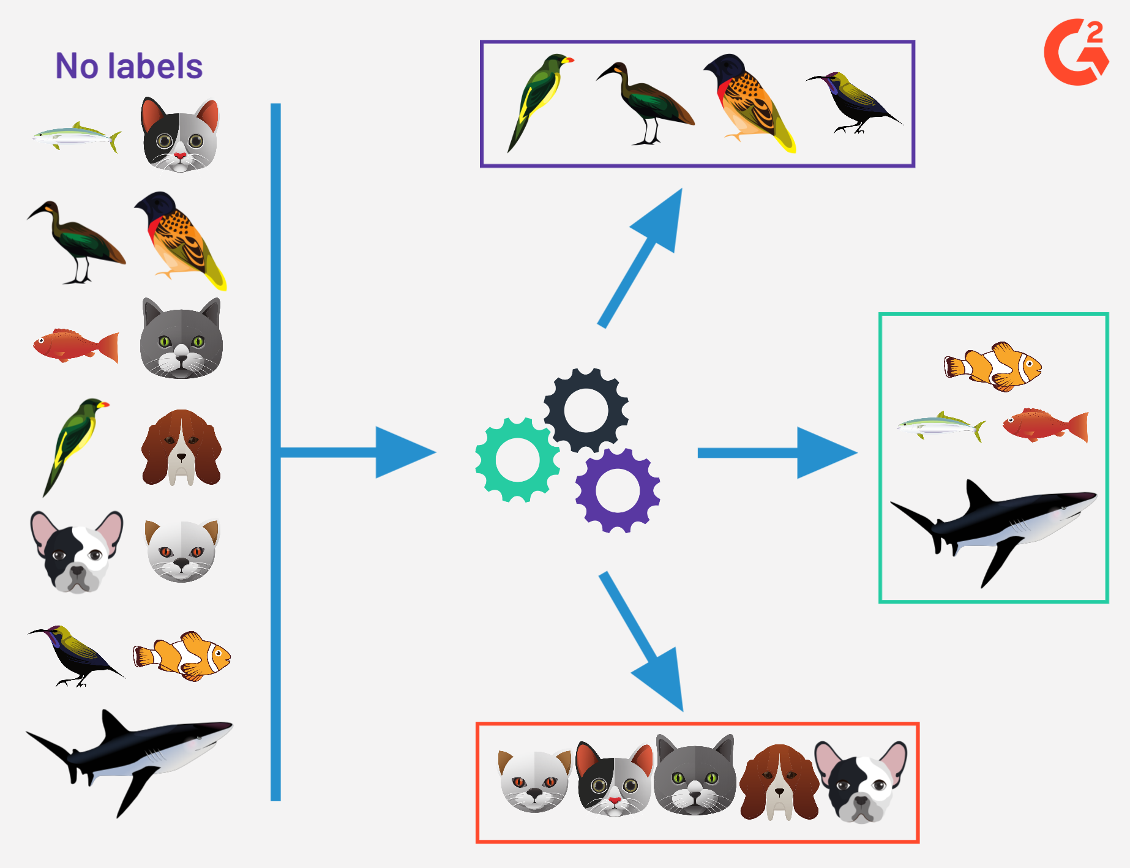
What is ML (Unsupervised)?
Train an AI model without labeled data

Slide 23
What is Computer Vision?
How does a computer “see”?
PIXELS, MATH, PATTERN RECOGNITION, EDGE DETECTION, FEATURE EXTRACTION
Notes:
How does a computer “see”?
PIXELS, MATH, PATTERN RECOGNITION, EDGE DETECTION, FEATURE EXTRACTION

Slide 24
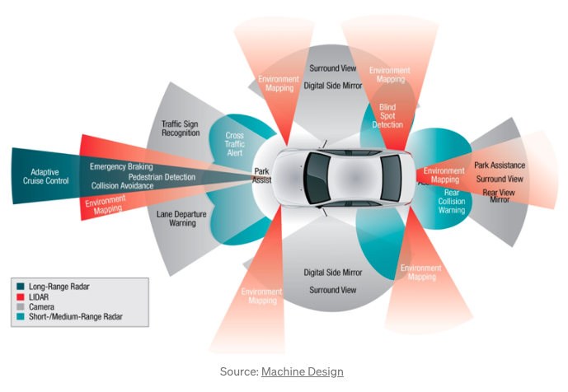
What is Computer Vision?
What are ways a computer inputs and represents data?
SENSORS
Notes:
How does a computer “see”?
PIXELS, MATH, PATTERN RECOGNITION, EDGE DETECTION, FEATURE EXTRACTION

Slide 25
Input
Storage and Processing
Output
Make a decision &
Solve a problem
Learning
SENSORS
Notes:
Sensors provide input that is processed by the AI model to produce an output.
Sensors allow us to automate input to the AI so that we don’t have to manually enter all the data the AI needs to produce an output.

Slide 26
What is NLP?
When you think of NLP, who or what do you think of?
NLP is the branch of AI that helps computers detect, understand, interpret, and manipulate human language in ways that are context aware.

Slide 27
Importance of Understanding about AI
Why does it matter to "learn and understand about AI"?
AI All Around Us
Important to understand what AI is to effectively interact with AI technologies in our daily experiences where AI is commonplace
Broaden more opportunities not just enhance efficiency in current fields, but also unlock future career pathways
Exposure to learning about AI would be beneficial for both students as well as teachers (AI Literacy)

Slide 28
Activity 1. Train Binary Classification AI Model
Notes:
Now let’s move on to first activity ML with tangible tools.

Slide 29
Binary Classification AI Model
We often want to know if something belongs to one group or another. For example:
Poisonous vs Non-poisonous
Recyclable vs Trash
Legal vs Illegal
Note: Somethings are easier to classify than others and not all classification problems are binary.

Slide 30
Benefits of using the binary model in K-12 context
Simplifies AI Concepts for Young Learners
Binary classification follows a straightforward yes/no or true/false structure, making it easier for young students to grasp.
Hands-on Learning with Real-World Applications
Students can build simple AI projects using binary classification, such as identifying spam emails or predicting whether a sentence is positive or negative.

Slide 31
AI Classification Machine
Input
Image
Sound
Pose
for training AI model
Processing
AI +Programming + Micro:bit
Output
Actuators
(Servomotor, LED Light, etc)

Slide 32
What we will do…
Create an AI model
Build
Code
Connect the AI model to the Micro:bit
Test
Share

Slide 33
Creating an AI model with Machine Learning

Slide 34
It starts with a…
GOAL
Understanding the goal will help to identify the type and content of the data needed, the analysis approach, and how to measure success.

Slide 35
Then comes the…
Data
Types of data:
Numerical/Categorical
Text
Images
Audio/Video
Almost anything that can be digitized

Slide 36
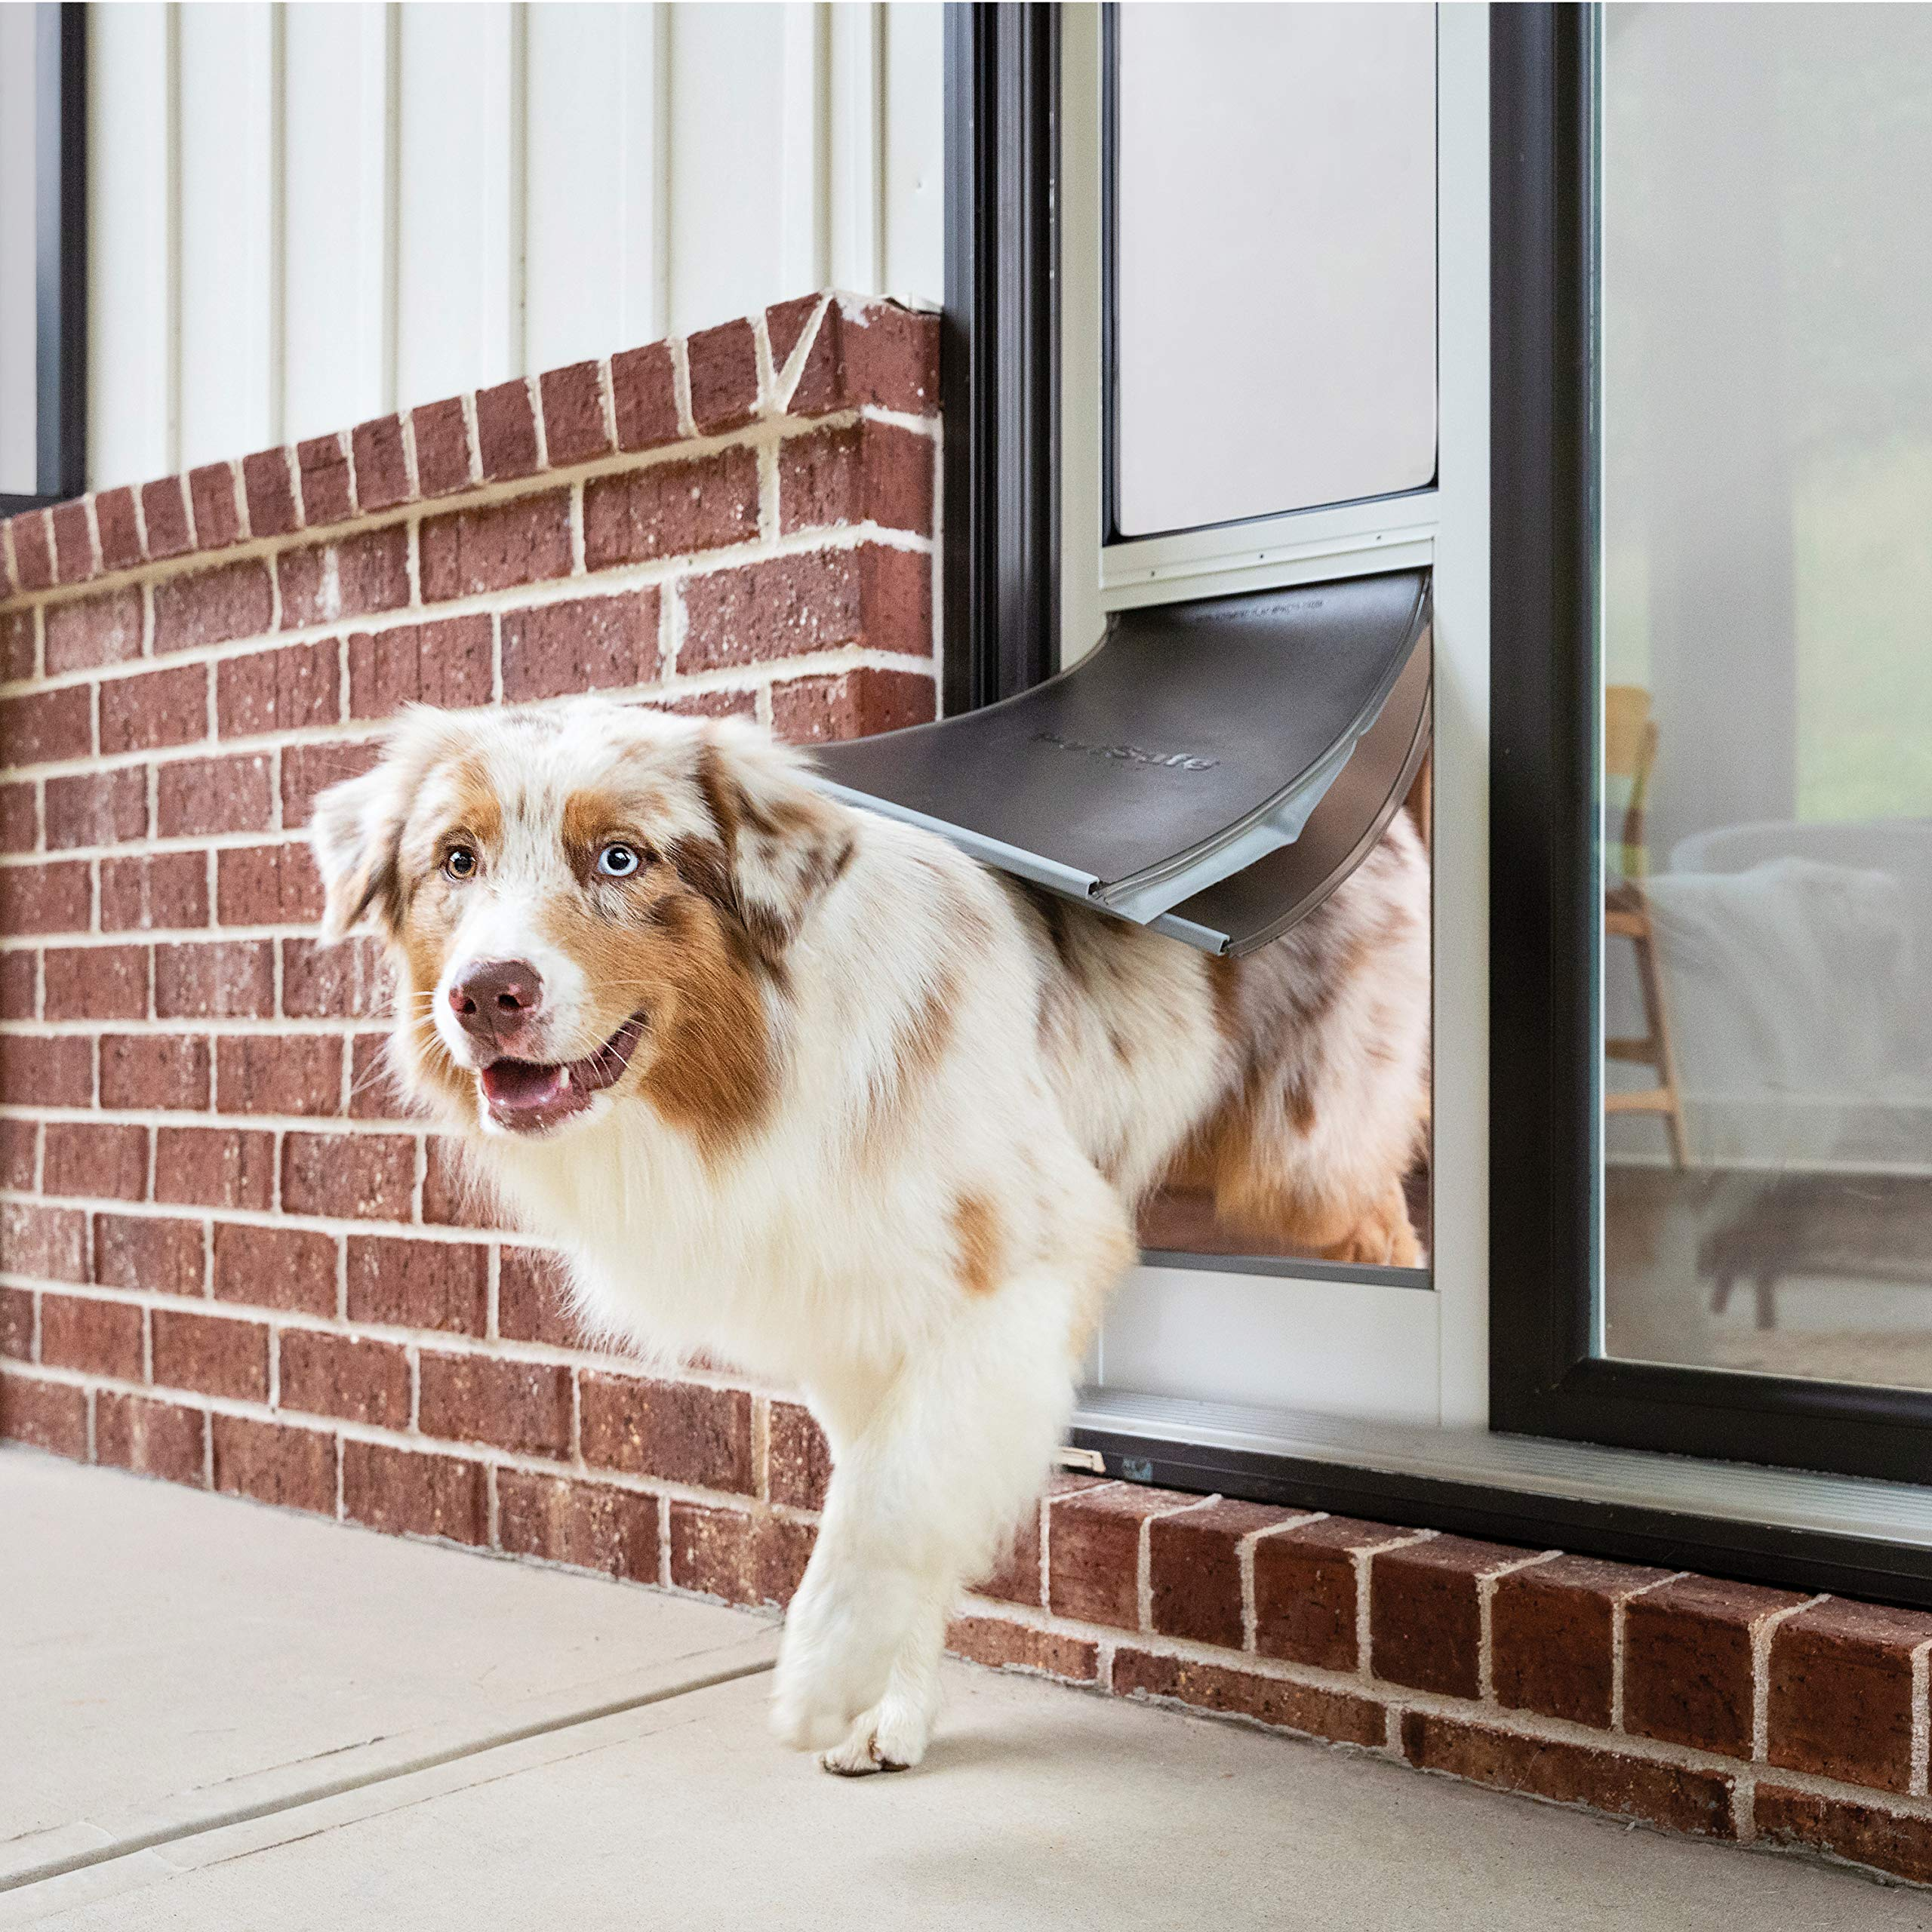
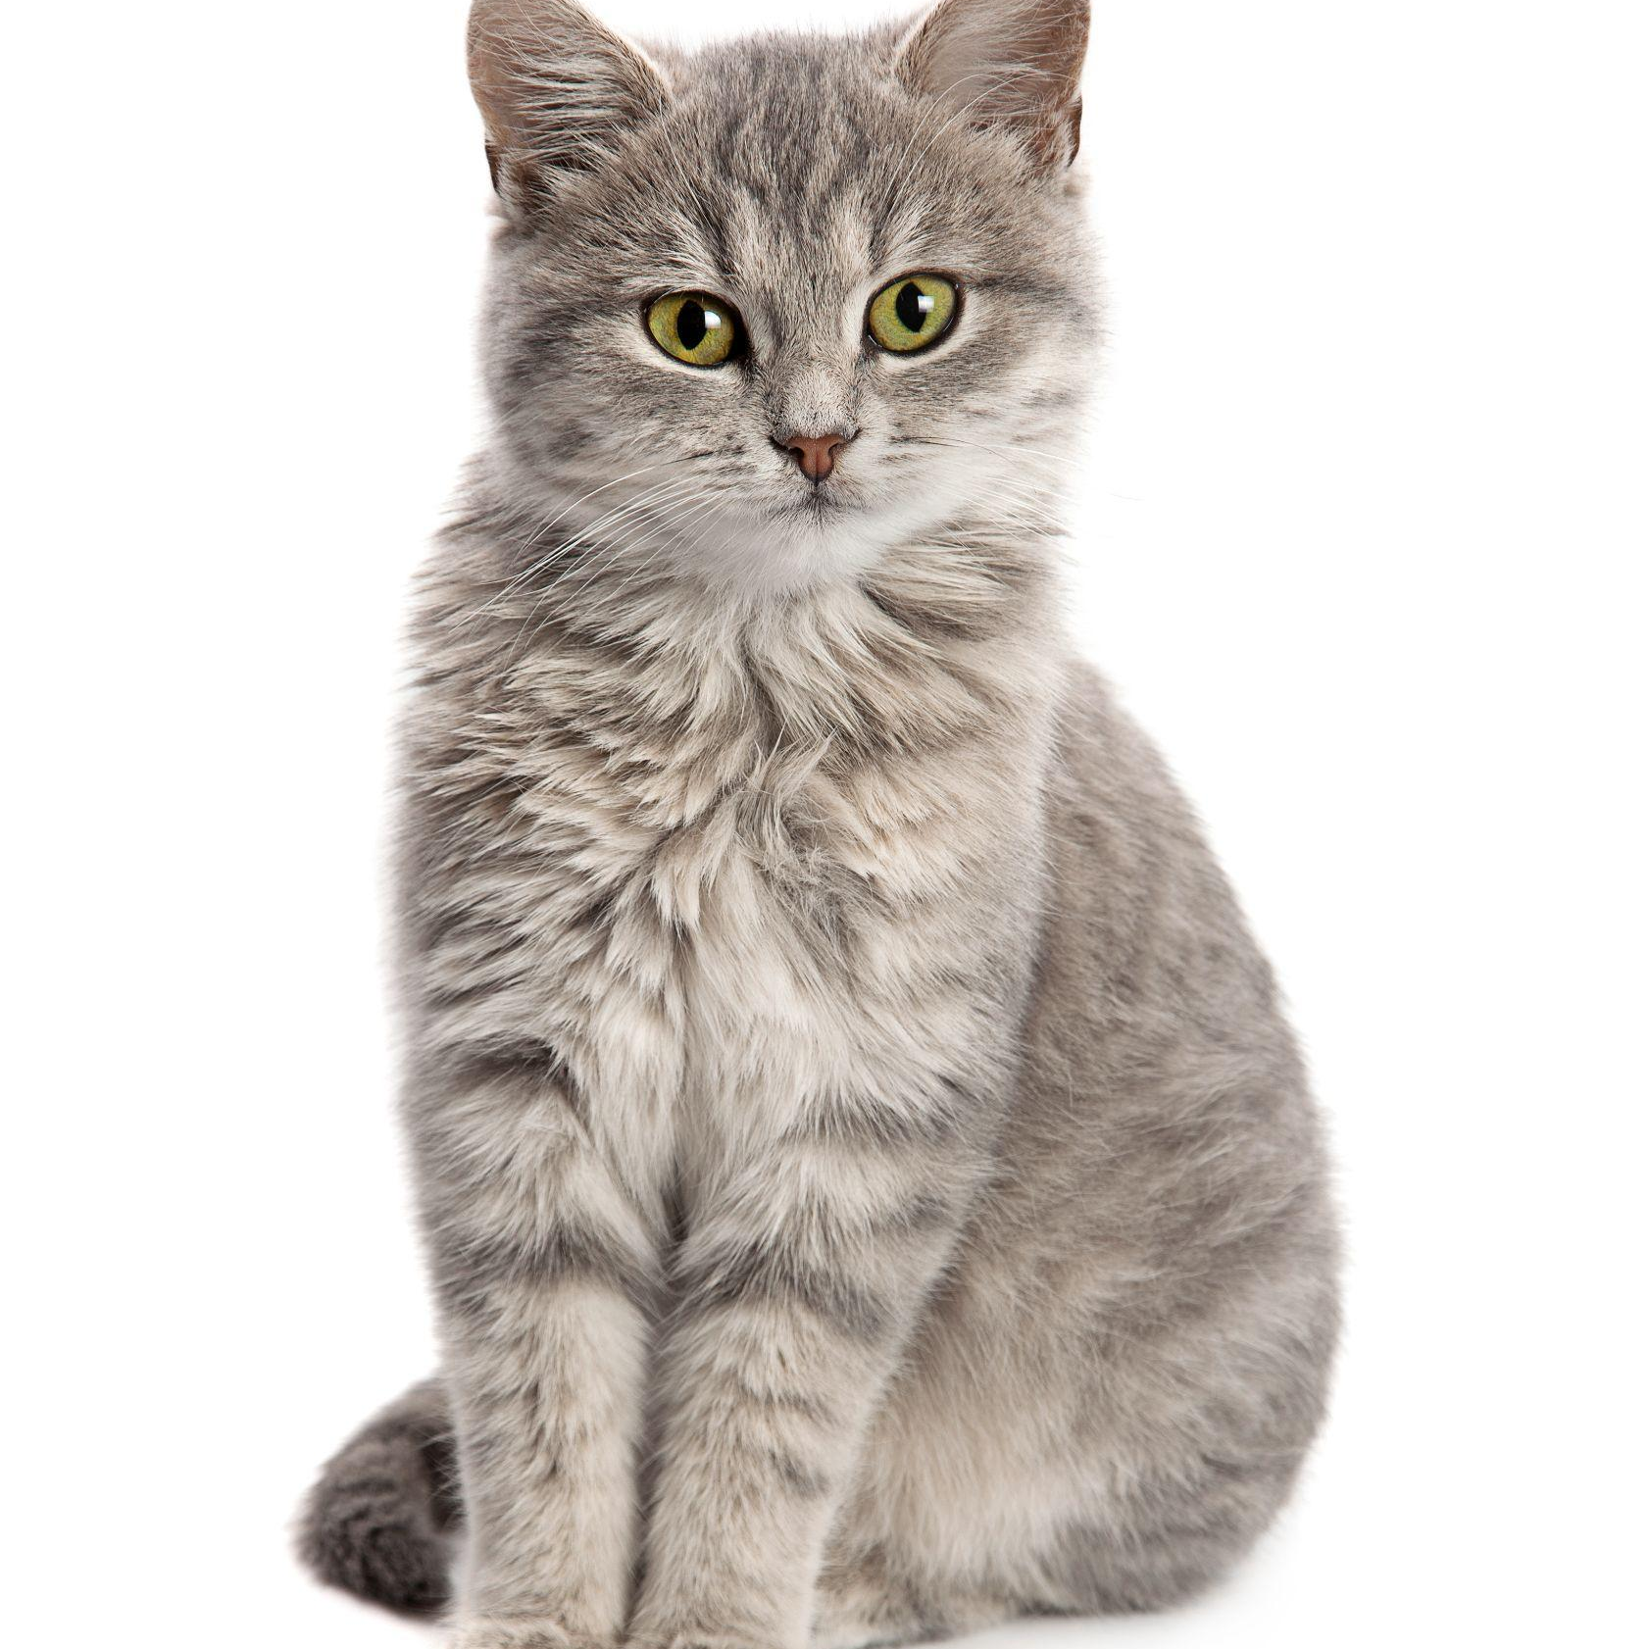
If the goal is…
To build a pet door that will only allow your pets through.
What type of data do you need?
What should that data contain?
Images of our pets.

Slide 37
If the goal is…
To build a system that suggest improvements to your posture when you work out…
What type of data do you need?
What should that data contain?
Images of people working out
with correct posture.

Slide 38
data data data…
Data!
Data is important!
Machine learning needs a lot of high quality, relevant data that is free of bias.

Slide 39
Next comes the…
Training
During training, an algorithm is used to learn the patterns and relationships within the data. The results of the training is a model.

Slide 40
The Machine Learning Process
Data
Training
Train the model
Test
Deploy
Retrain Adjust the data and/or algorithm

Slide 41
Let’s Create an AI Model!
We will create an AI model using Google Teachable Machines to classify two (or more) things. For example,
Checked Shirt vs Plain Shirt
Red Objects vs Green Objects
Wearing Glasses vs Not Wearing Glasses
You can choose! In groups of 2, decide what you will classify.
Note: It must be something that you can capture with your laptop’s web camera.

Slide 42
Before we start, let's think about...
Which topics are best suited for applying a binary classification model?
What kind of input we can use to train the AI model? (image, voice, pose, etc)
Discuss and share your thoughts.
Think of real-world applications and AI-driven classroom activities! 🚀

Slide 43
Capturing Poses
Consider…
What is your target and what else is in the poses that you are capturing. Are there a lot of other object’s creating “noise” that might confuse the algorithm?
How many images will you need to capture?

Slide 44
AI Squat Machine!!
Let's create an "AI Squat Machine" using two poses:
Sit Down Pose – when you are in the squat position (knees bent, body low).
Stand Up Pose – when you are standing straight (legs straight, back upright).
OR
You can create your own binary AI model regarding your school subject!

Slide 45
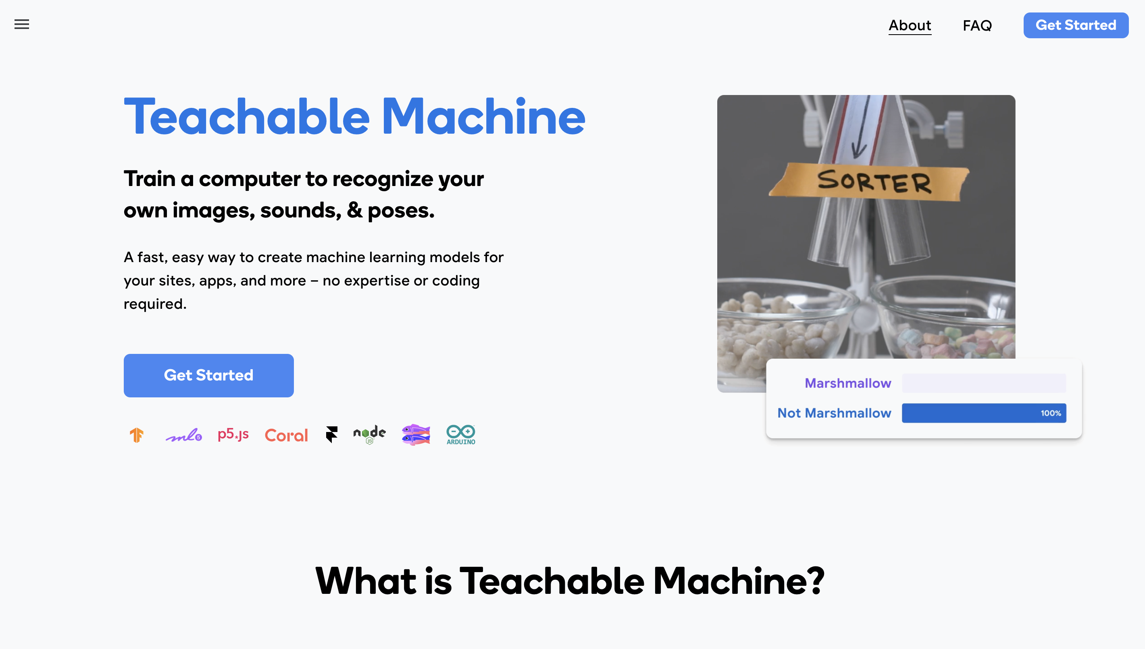
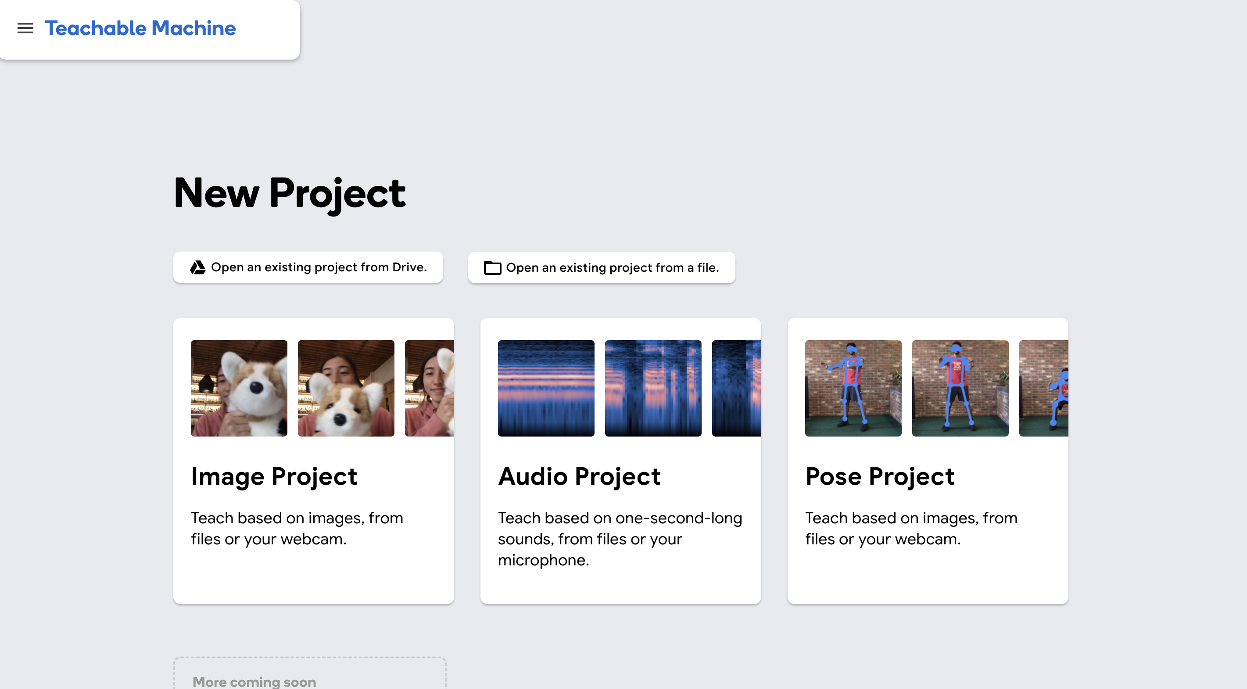
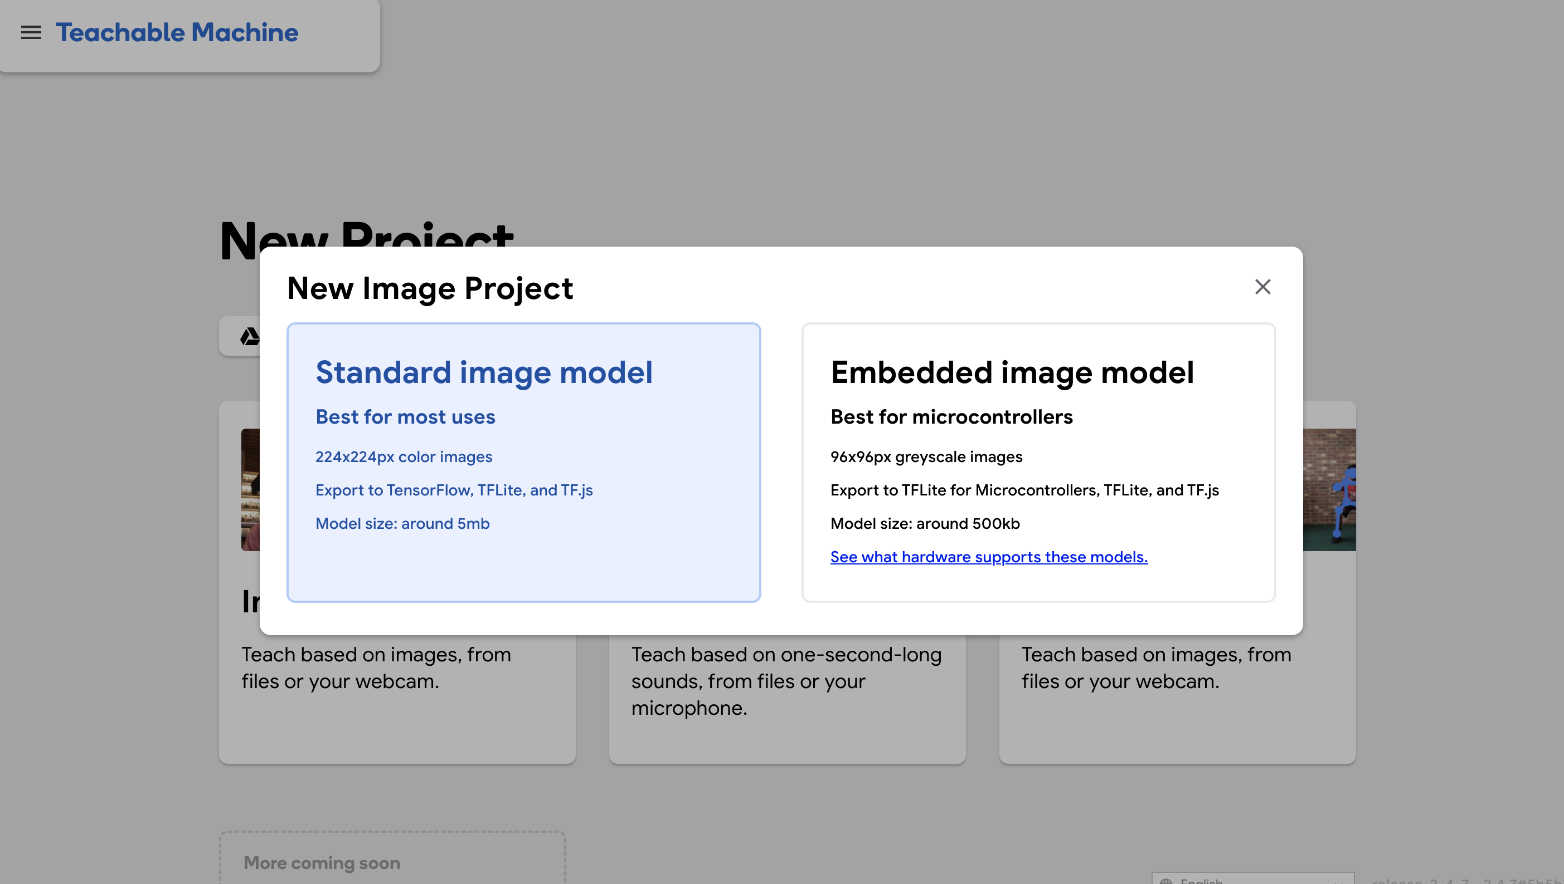
Go to Google Teachable Machine.
Click the Get Started button.
If you choose Image project, Click on Standard image model.
Click on Pose Project.

Slide 46
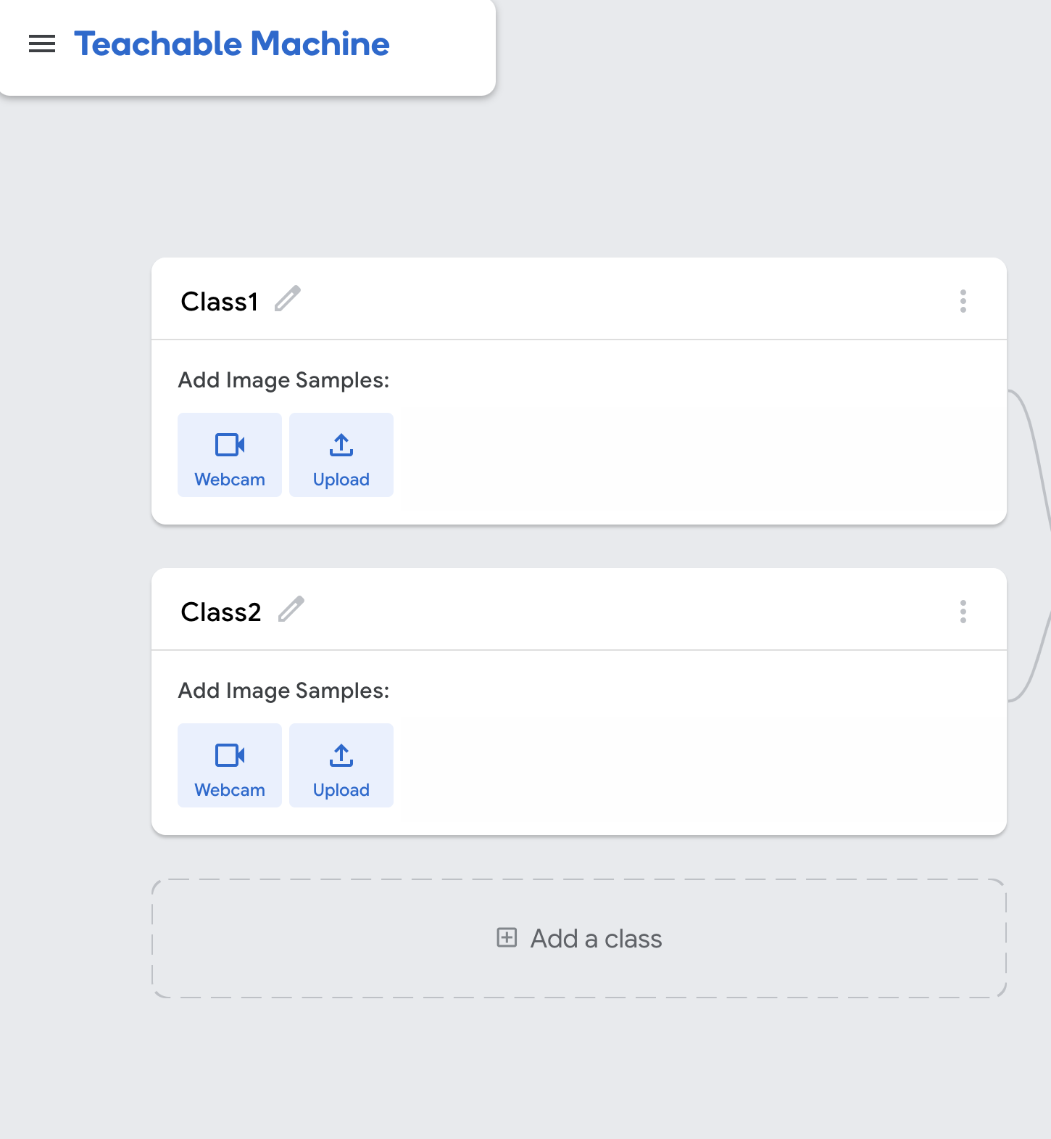
Rename the classes.
(Please name it as a number (e.g., 1 and 2))
We will use these names to build and program our device.

Slide 47
AI Squat Machine!!
To capture images, click the webcam button.
Note: You may get an alert requesting access to your webcam. Allow access.
Hold your target item up in front of the camera and click the Hold to Record button.

Slide 48
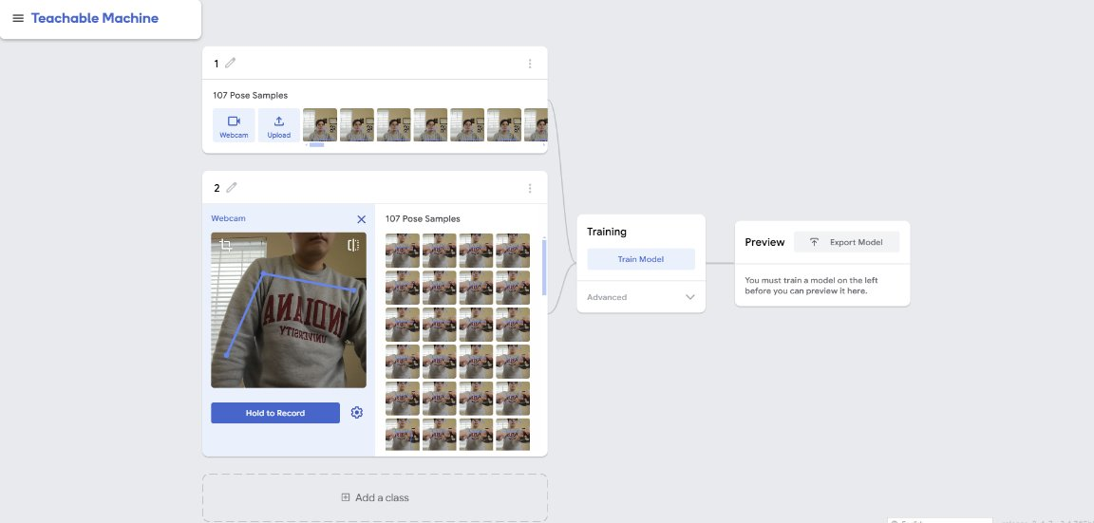
Once you have captured images (data) for both classes. And please make sure to capture more than 100 images for each class!
Click the Train Model button.
Note: Do not switch tabs while it is training.

Slide 49
After the model is trained, check to make sure it can predict the class correctly (approx. > 95%)

Slide 50
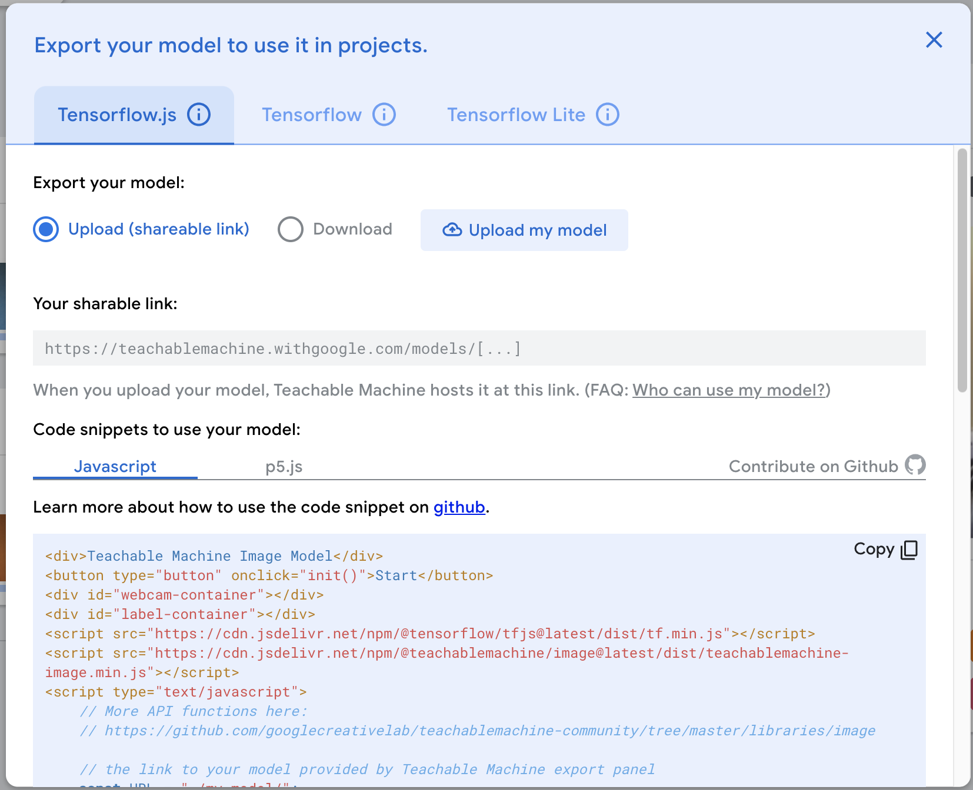
If the predictions are good, click the Export Model button. If not, please add more data, and retrain the model!
Then click the Upload my model button.

Slide 51
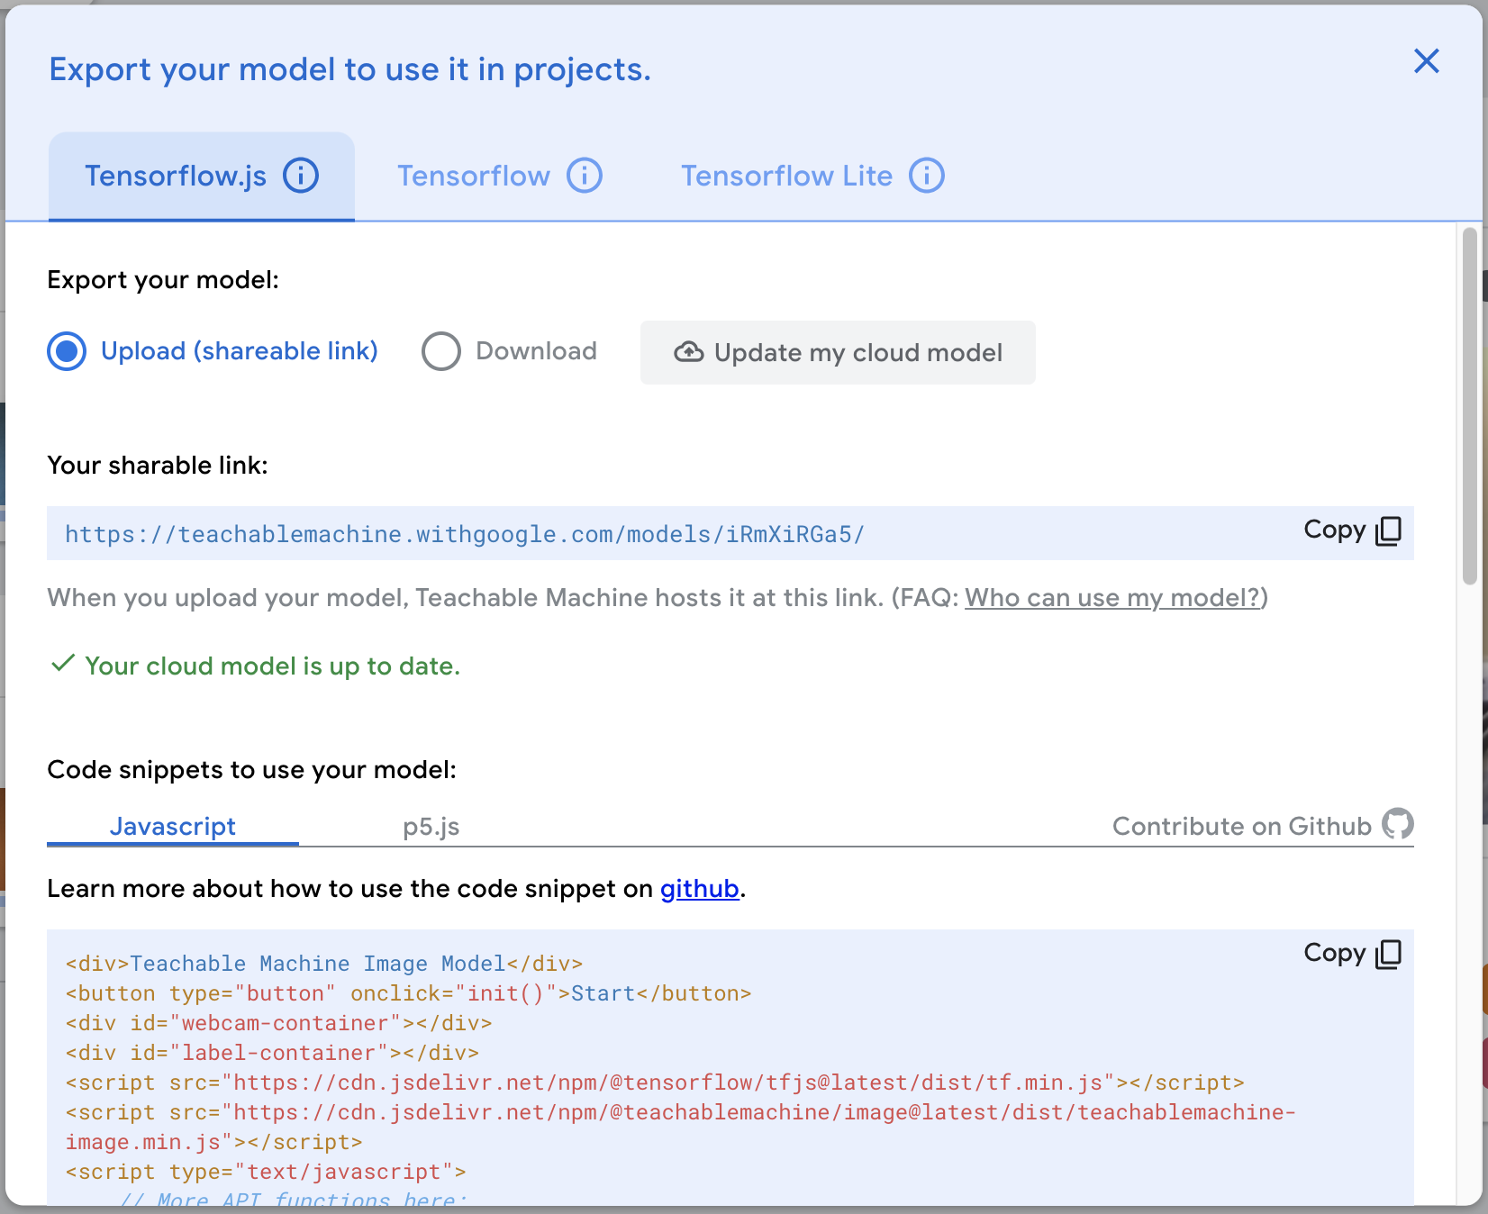
After the model is uploaded there will be a green checkmark.
Pause here.
Leave this browser tab open, we will use the shared URL for the model later.

Slide 52
Activity 2. Build AI Classification machine
Notes:
Now let’s move on to first activity ML with tangible tools.

Slide 53
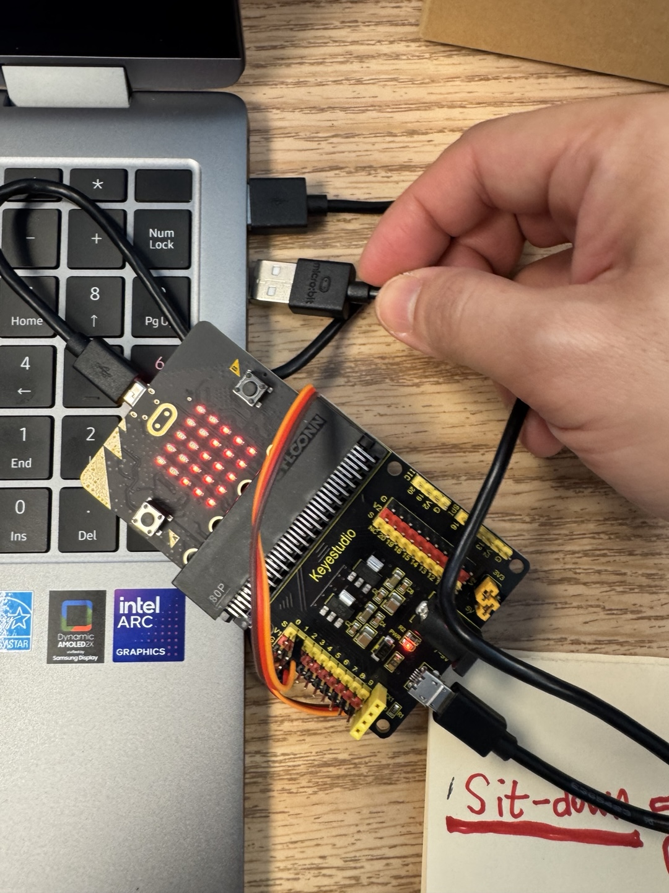
Connect the AI machine to your laptop!
Make sure to connect two USB cables to the ports

Slide 54
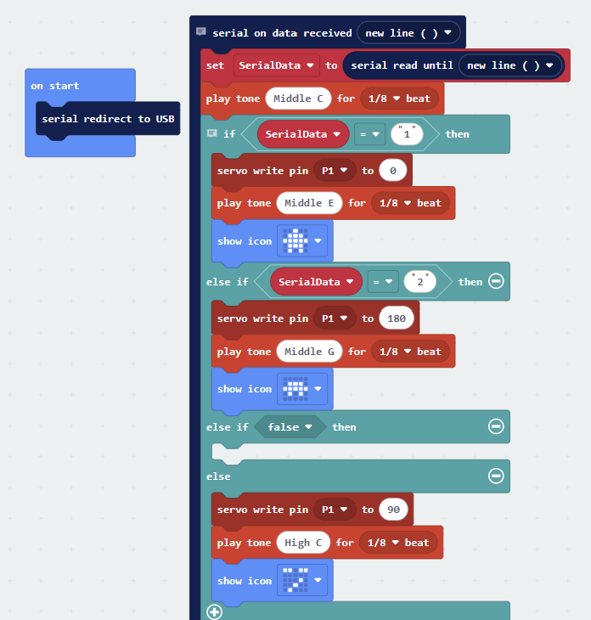
Open the code:
https://bit.ly/ai-classifier

Slide 55
On Start Block (Initialization)
The "serial redirect to USB" ensures that data sent through the serial port is transmitted via USB, making it easier to communicate with a computer.

Slide 56
On Serial Data Received
When the Micro:bit receives a new line of serial data, it:
Reads the incoming data.
Stores it in a variable called SerialData.
Plays a short tone (Middle C) to indicate that data has been received.

Slide 57
If SerialData = "1" ✅ Move servo motor to 0° (pin P1) ✅ Play Middle E tone ✅ Show an icon on the micro:bit screen
If SerialData = "2" ✅ Move servo motor to 180° (pin P1) ✅ Play Middle G tone ✅ Show an icon
Else (Default Case) ✅ Move servo motor to 90° (pin P1) ✅ Play High C tone ✅ Show an icon

Slide 58
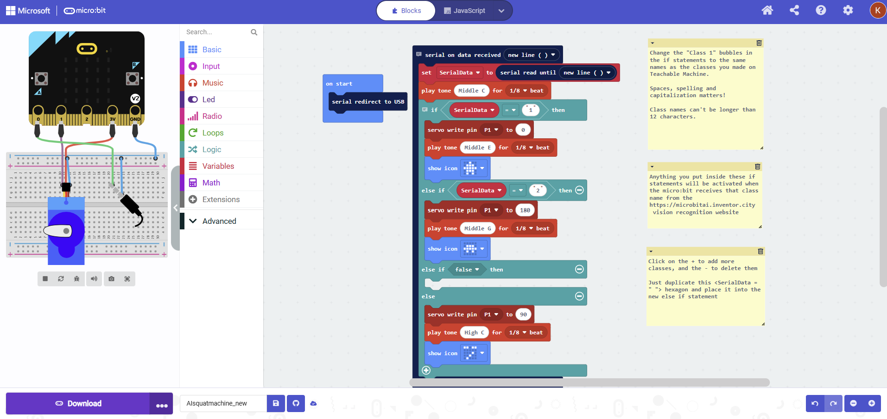
Note: If the "Connect Device" button doesn't work:
Click the three dots (…) and select Download Code.
Drag and drop the downloaded file directly into the MICROBIT D: folder.
Click the Download button and connect the device

Slide 59
Go to A Micro:bit of AI website:
https://makeairobots.com/
Click the Pair Microbit button.

Slide 60
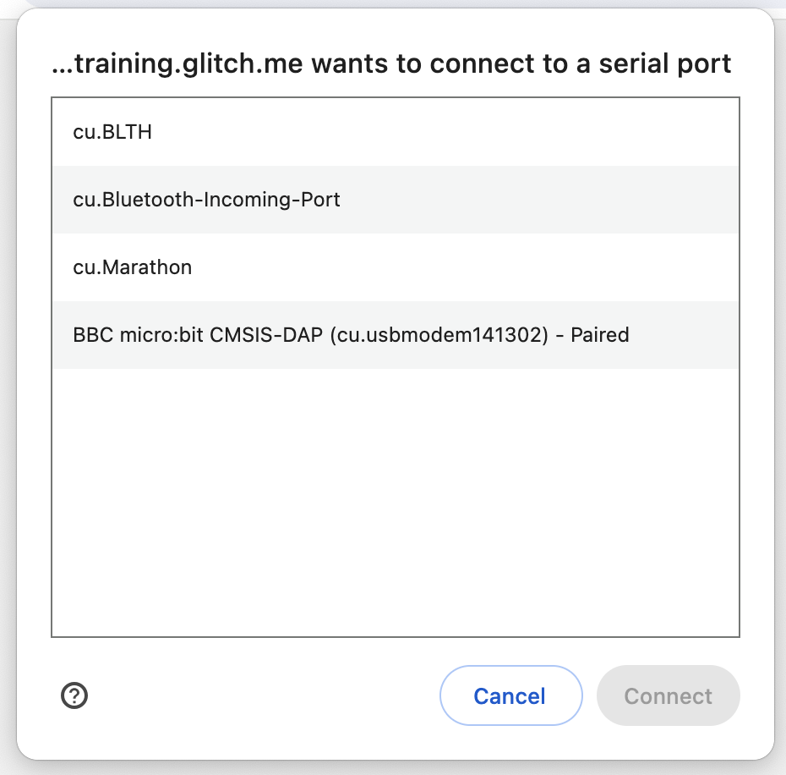
Select the Micro:bit.
Click the Connect button.

Slide 61
Go back to the Google Teachable Machines browser tab.
Copy the shareable link to your model.

Slide 62
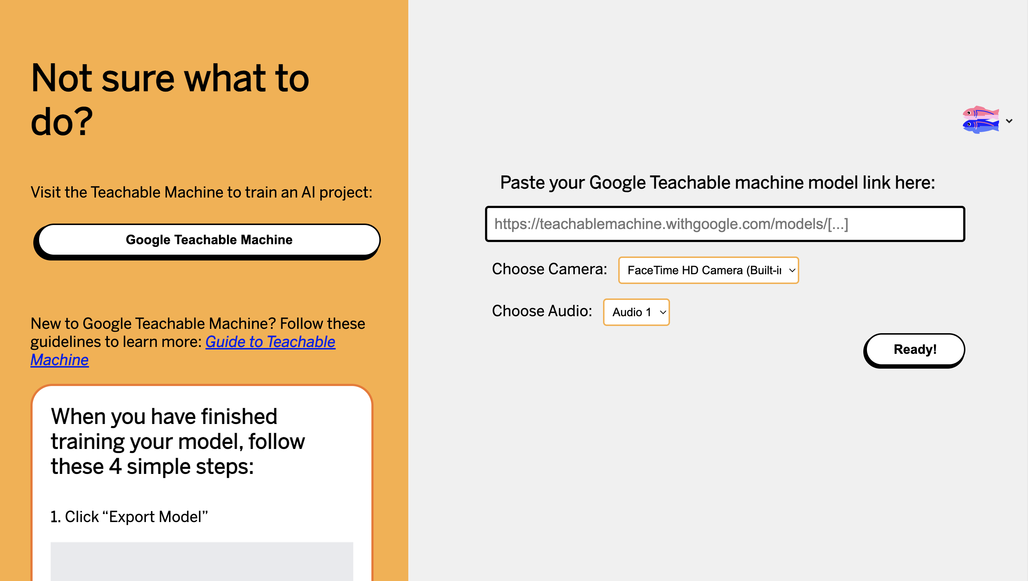
Paste the shareable link for your AI model from Google Teachable Machines here.
(e.g., https://teachablemachine.withgoogle.com/models/-U_FCK84T/
https://teachablemachine.withgoogle.com/models/I7NmEIUAP/)
Click the Ready button.

Slide 63
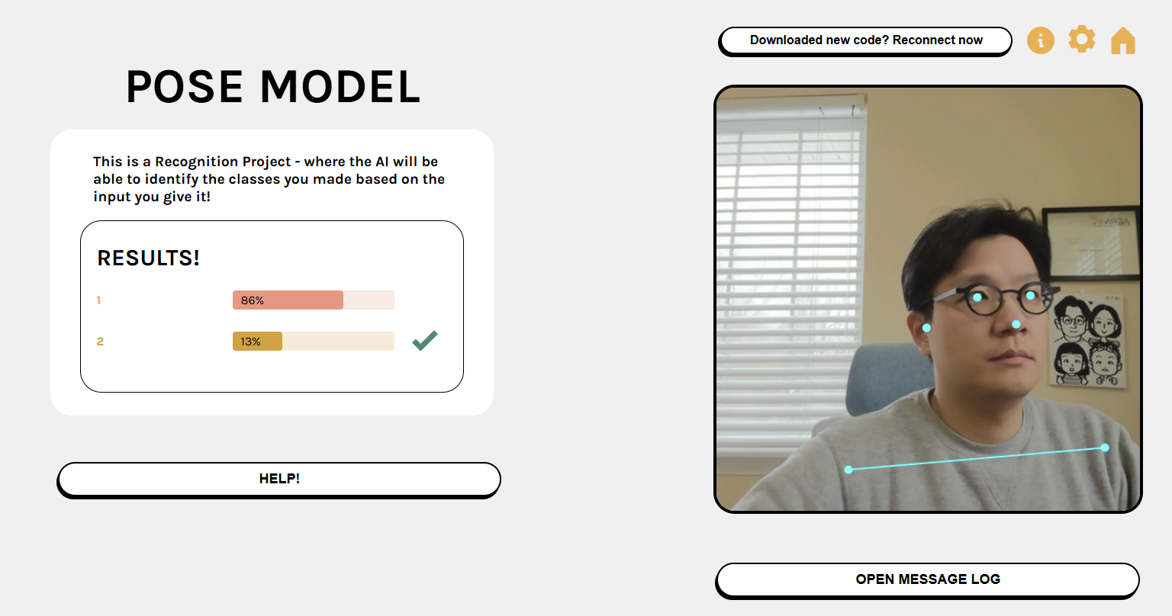
The image input captured by webcam.
The models prediction based on the image input.

Slide 64
Test your Classification Machine
Test with new data (data that you did not use to train the AI model).
Does it classify the new data correctly?
If not, what could you do to fix it?

Slide 65
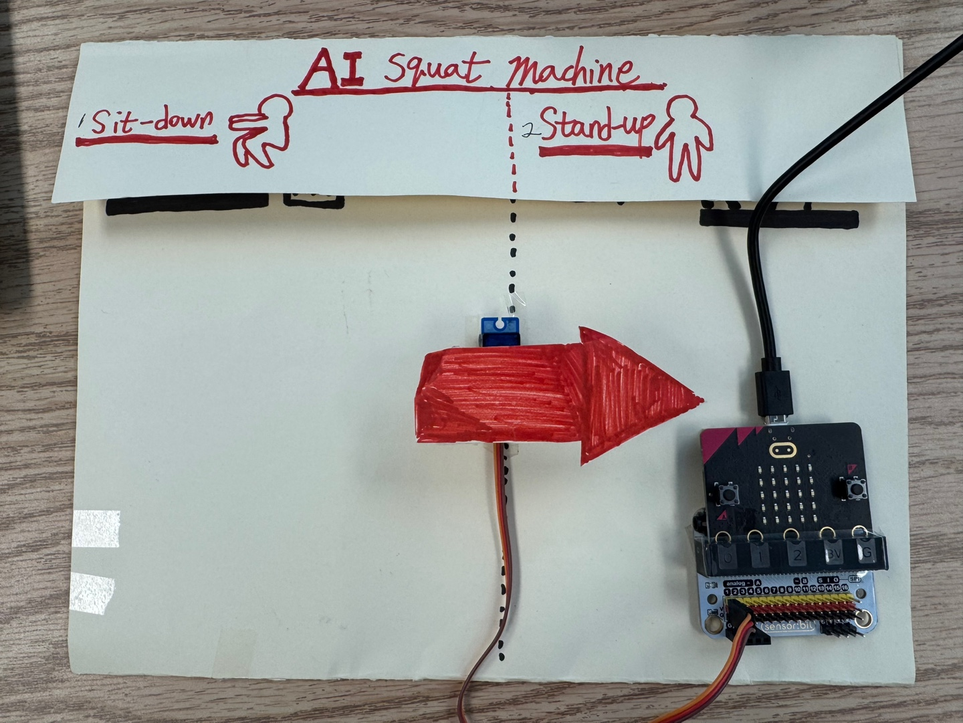
Finish your AI machine by making signs with paper and a marker!

Slide 66
Who wants to share their
AI Classification Machine?

Slide 67
Discussion
What were your challenges during this activity?​
How could this activity be adapted to integrate with your curriculum?
What should be considered before integrating this activity into the curriculum?​

Slide 68
Let's create an AI machine related to your teacher's school subject!

Slide 69
Assessment Design using Generative AI
https://ai.ctlt.ubc.ca/assessment-design-using-generative-ai/

Slide 70
Indiana Learning Lab
https://inlearninglab.com/

Slide 71
Any Questions? Comments?

Slide 72
Discussion AI policy, guidelines & experiences in Educational Setting

